Slide 1
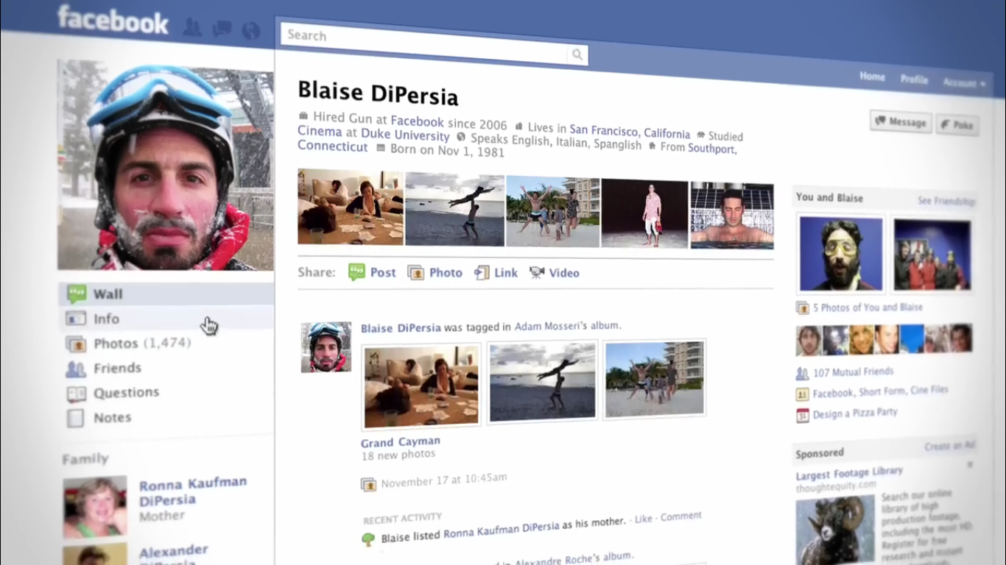
Basic 05
Meeting New People

Slide 2
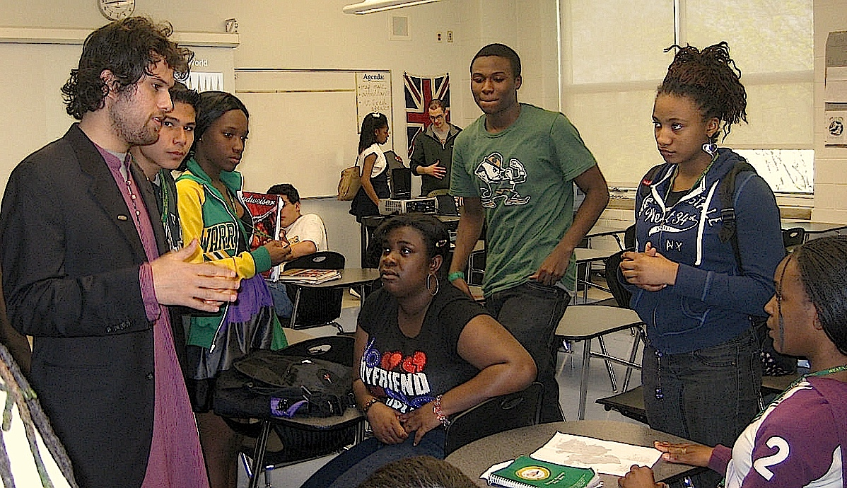
Get to know your classmates

Slide 3
Ask your classmates about…
her/his name
What is your name?
-her/his age
How old are you?
-about the place he lives in.
Where do you live?
-if she/he is an only child.
Are you an only child? /
Do you have any brothers or sisters?
-about the languages he speaks.
Which languages do/can you speak?
-if she/he has a dog or a cat.
Do you have a dog? / Do you have a cat? / Do you have a pet?
-if she/he has a best friend.
Do you have a best friend?
-about the activities she/he enjoys doing on vacation. (entertainment activities)
What do you do for fun on your vacation?

Slide 4
Ask your classmates about…
her/his name
her/his age
the place he lives in.
if she/he is an only child.
the languages he speaks.
if she/he has a dog or a cat.
if she/he has a best friend.
the activities she/he enjoys doing on vacation. (entertainment activities)

